Slide 1
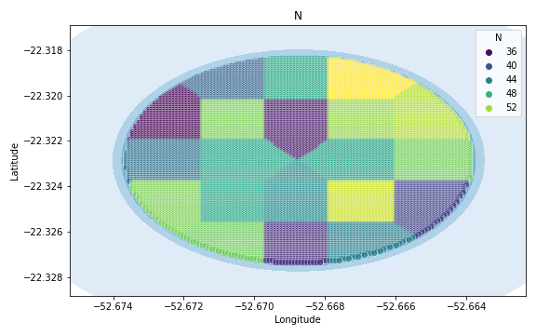
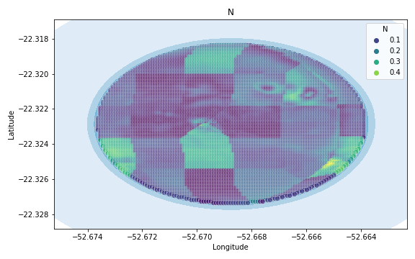
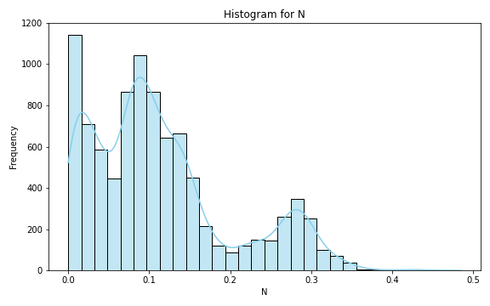
Analysis for column: N Model: Neural Network
Statistics:
mean 0.112790
std 0.087117
min 0.000004
25% 0.045127
50% 0.094718
75% 0.146444
80% 0.166266
85% 0.223595
90% 0.269154
95% 0.291374
99% 0.330821

Slide 2
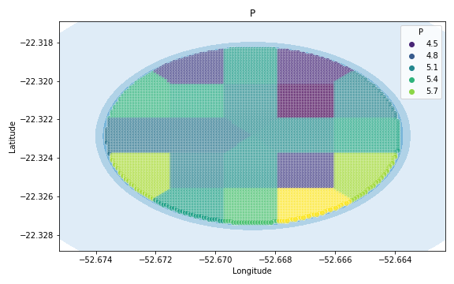
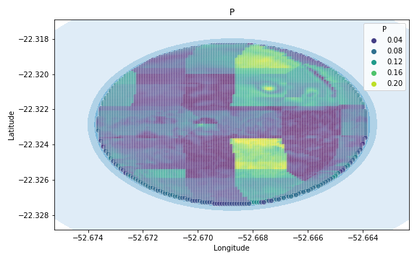
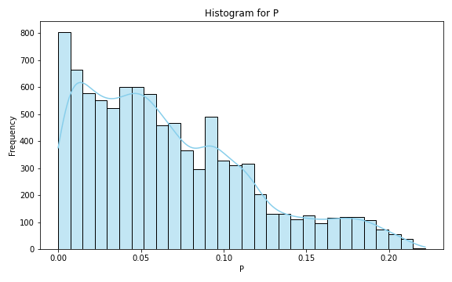
Analysis for column: P Model: Neural Network
Statistics:
mean 0.066815
std 0.050448
min 0.000010
25% 0.025842
50% 0.056202
75% 0.096853
80% 0.108115
85% 0.118885
90% 0.141925
95% 0.172640
99% 0.200137

Slide 3
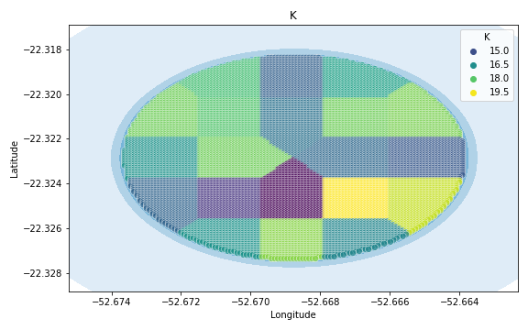
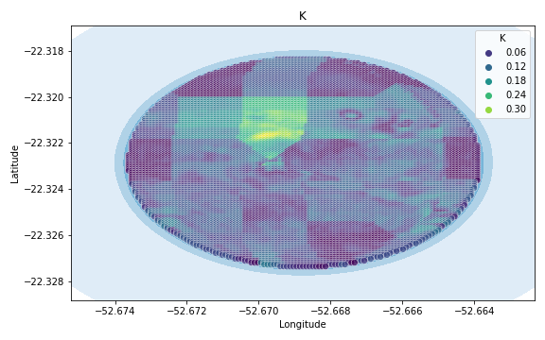
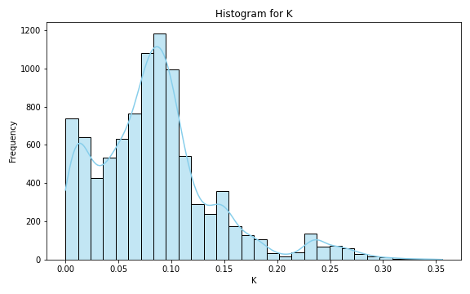
Analysis for column: K Model: Neural Network
Statistics:
mean 0.086014
std 0.057864
min 0.000004
25% 0.047614
50% 0.081560
75% 0.107212
80% 0.117417
85% 0.136783
90% 0.154115
95% 0.213125
99% 0.270866

Slide 4
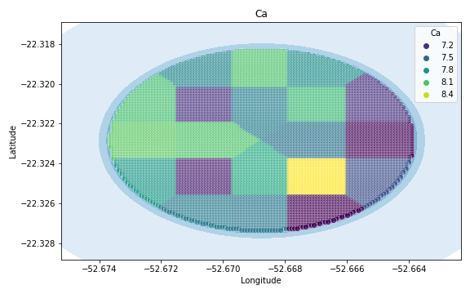
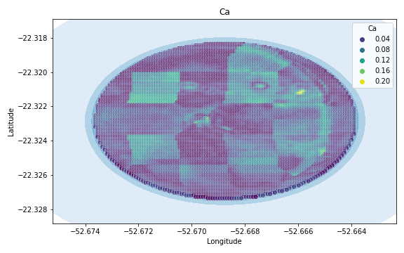
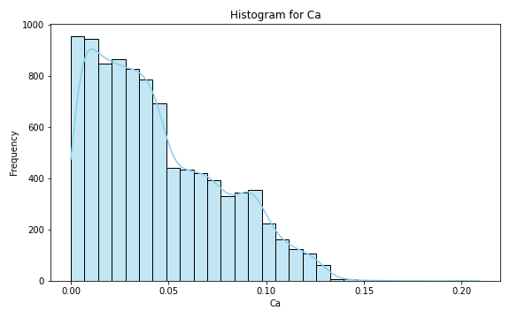
Analysis for column: Ca Model: Neural Network
Statistics:
mean 4.409139e-02
std 3.244591e-02
min 1.994613e-07
25% 1.752335e-02
50% 3.694586e-02
75% 6.640421e-02
80% 7.431547e-02
85% 8.397794e-02
90% 9.326849e-02
95% 1.051250e-01
99% 1.252085e-01

Slide 5
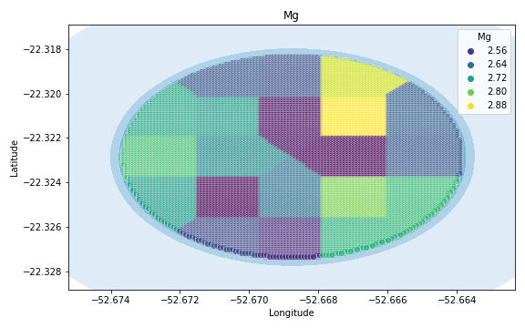
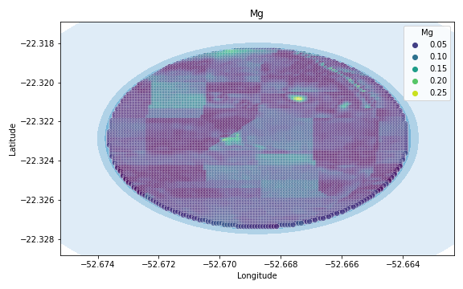
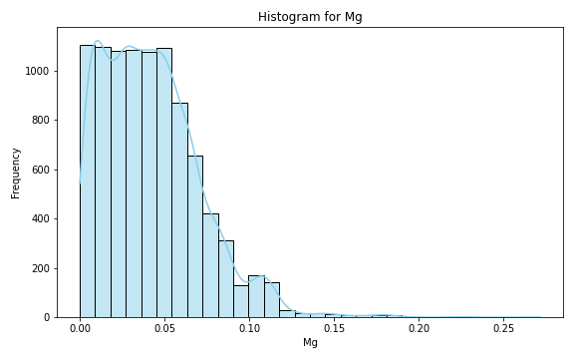
Analysis for column: Mg Model: Neural Network
Statistics:
mean 0.042231
std 0.029385
min 0.000006
25% 0.019205
50% 0.038976
75% 0.059230
80% 0.064363
85% 0.070279
90% 0.080243
95% 0.096353
99% 0.122641

Slide 6
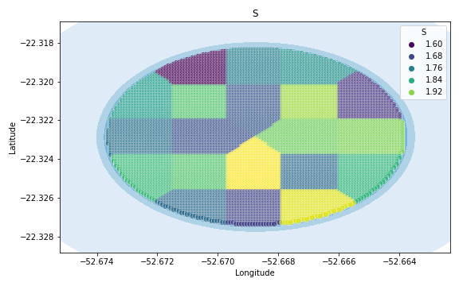
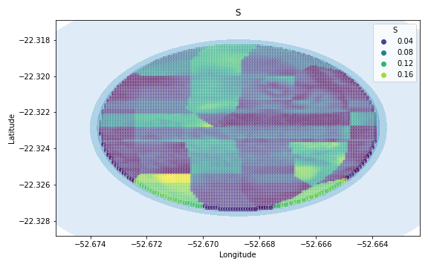
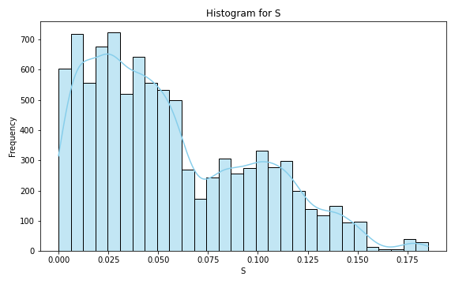
Analysis for column: S Model: Neural Network
Statistics:
mean 0.055870
std 0.041144
min 0.000002
25% 0.022885
50% 0.045912
75% 0.086340
80% 0.097278
85% 0.106378
90% 0.116373
95% 0.134401
99% 0.154494

Slide 7
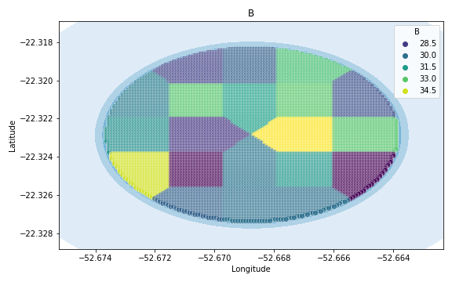
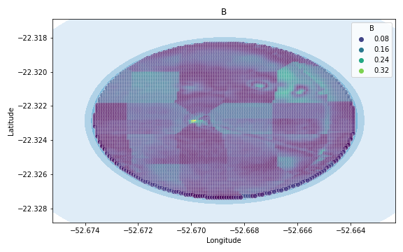
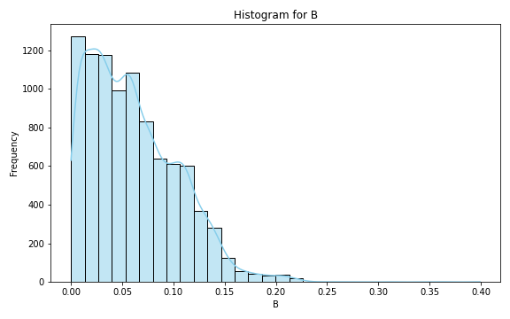
Analysis for column: B Model: Neural Network
Statistics:
mean 0.060671
std 0.043503
min 0.000016
25% 0.025348
50% 0.053946
75% 0.089444
80% 0.100008
85% 0.110287
90% 0.120836
95% 0.138021
99% 0.185492

Slide 8
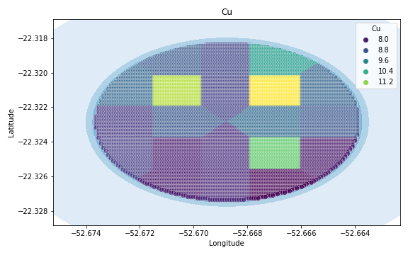
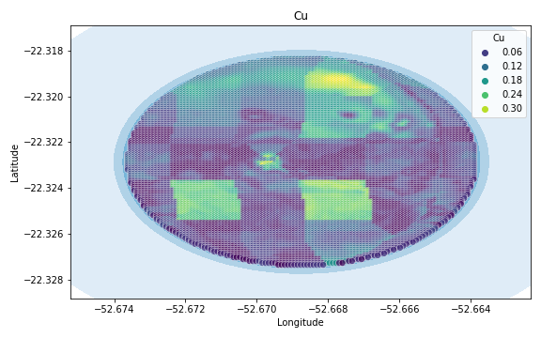
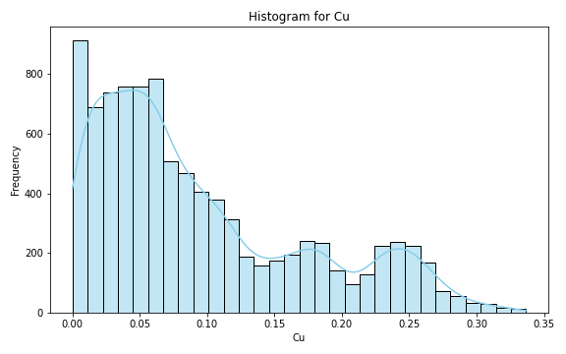
Analysis for column: Cu Model: Neural Network
Statistics:
mean 0.094836
std 0.079077
min 0.000020
25% 0.033600
50% 0.068147
75% 0.142716
80% 0.171238
85% 0.193474
90% 0.230732
95% 0.253991
99% 0.291596

Slide 9
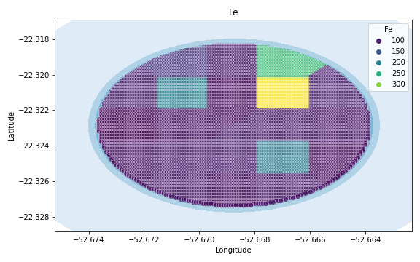
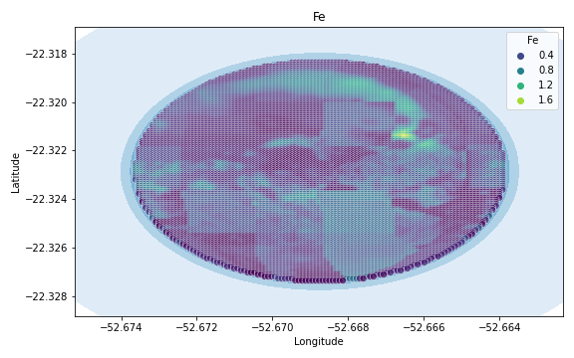
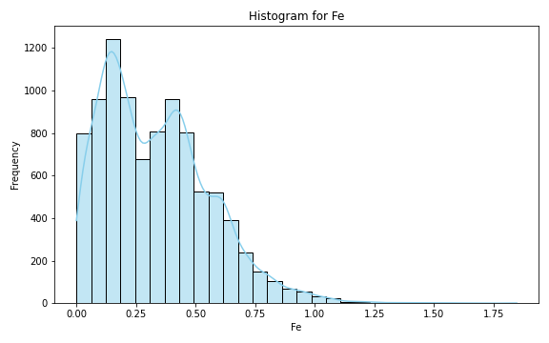
Analysis for column: Fe Model: Neural Network
Statistics:
mean 0.335606
std 0.226033
min 0.000020
25% 0.150840
50% 0.310799
75% 0.472520
80% 0.520007
85% 0.581691
90% 0.632845
95% 0.736311
99% 0.971383

Slide 10
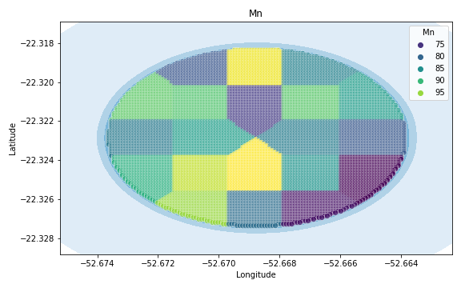
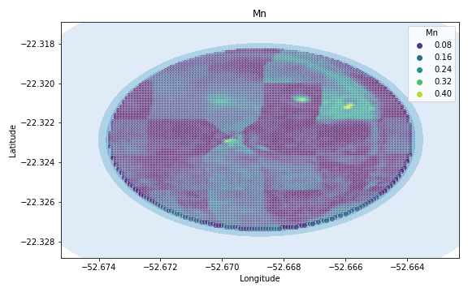
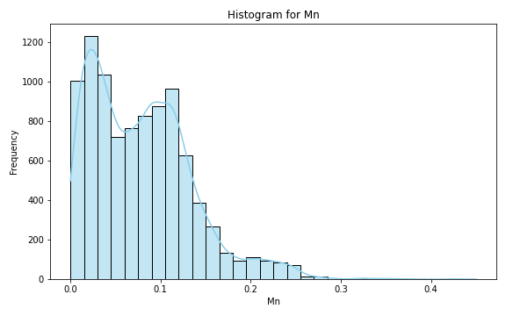
Analysis for column: Mn Model: Neural Network
Statistics:
mean 0.079089
std 0.056871
min 0.000011
25% 0.031413
50% 0.073540
75% 0.113456
80% 0.121460
85% 0.132059
90% 0.148762
95% 0.185956
99% 0.245369

Slide 11
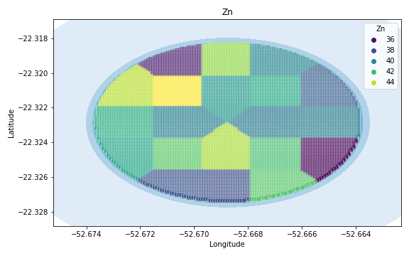
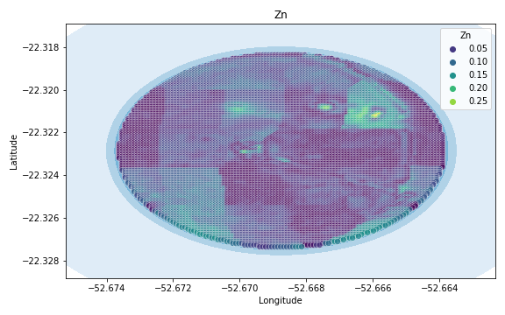
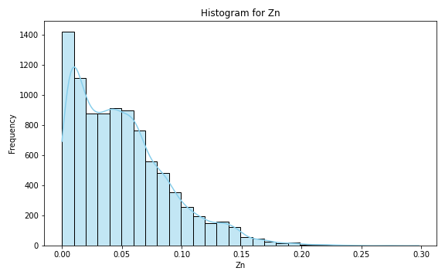
Analysis for column: Zn Model: Neural Network
Statistics:
mean 0.050443
std 0.039610
min 0.000007
25% 0.017824
50% 0.043831
75% 0.071533
80% 0.080625
85% 0.090045
90% 0.104683
95% 0.129995
99% 0.168453

Slide 12
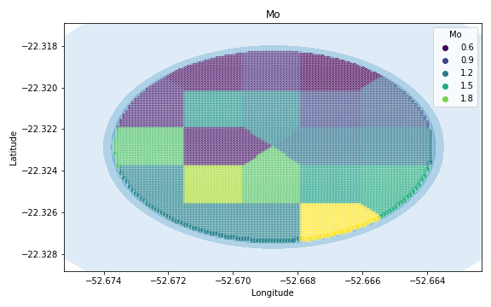
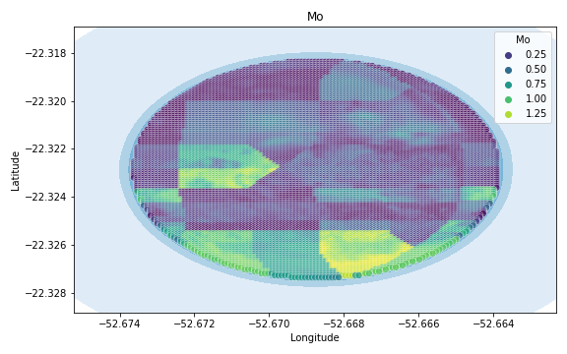
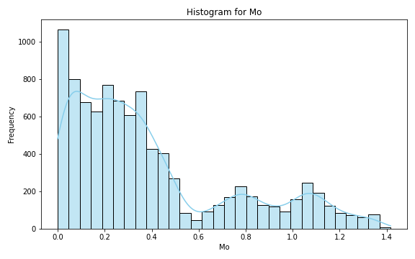
Analysis for column: Mo Model: Neural Network
Statistics:
mean 0.393031
std 0.349312
min 0.000008
25% 0.126793
50% 0.288642
75% 0.502948
80% 0.729547
85% 0.829605
90% 1.021904
95% 1.122303
99% 1.319183

Slide 13
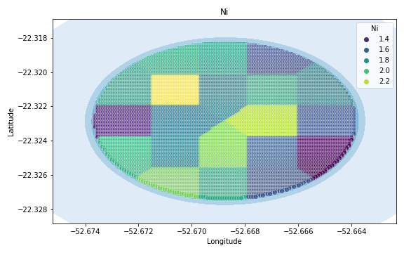
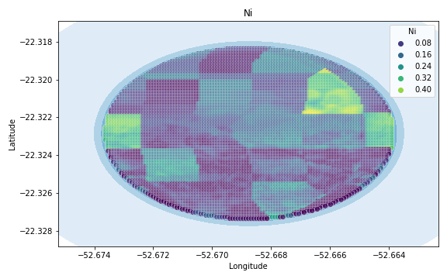
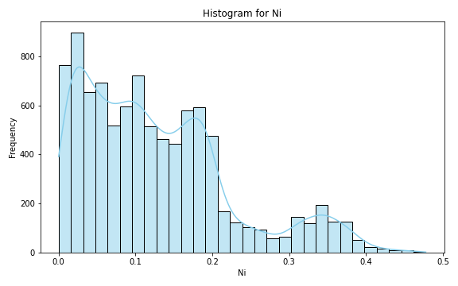
Analysis for column: Ni Model: Neural Network
Statistics:
mean 0.127323
std 0.097630
min 0.000037
25% 0.048666
50% 0.106991
75% 0.180840
80% 0.191818
85% 0.210760
90% 0.275413
95% 0.343024
99% 0.387465

Slide 14
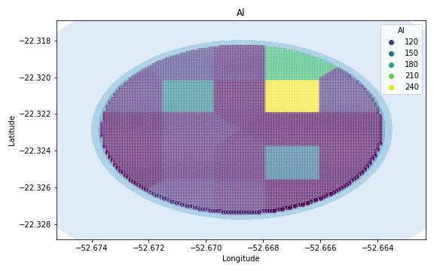
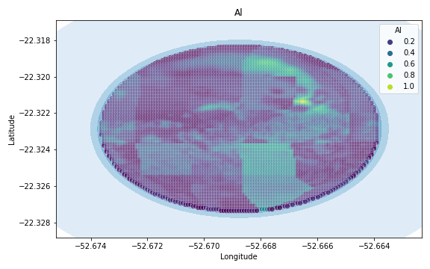
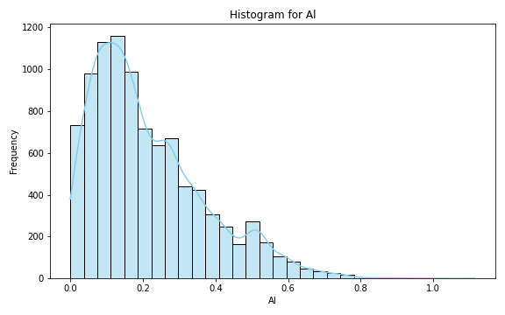
Analysis for column: Al Model: Neural Network
Statistics:
mean 0.213681
std 0.156348
min 0.000008
25% 0.094553
50% 0.172446
75% 0.297708
80% 0.337020
85% 0.382043
90% 0.445065
95% 0.524179
99% 0.664599

Slide 15
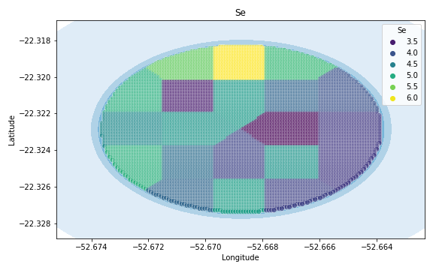
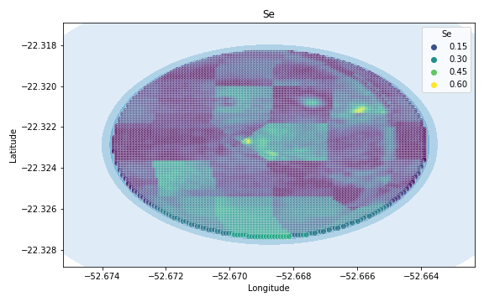
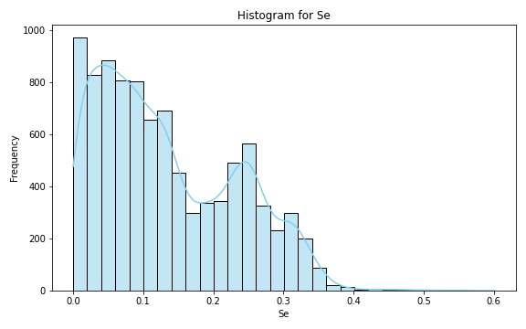
Analysis for column: Se Model: Neural Network
Statistics:
mean 0.134201
std 0.098238
min 0.000008
25% 0.051883
50% 0.112185
75% 0.216783
80% 0.237681
85% 0.255255
90% 0.276988
95% 0.312365
99% 0.353307

Slide 16
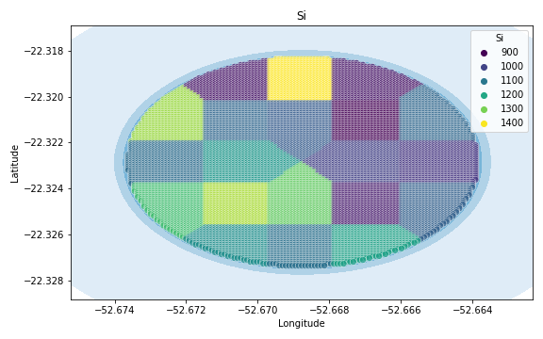
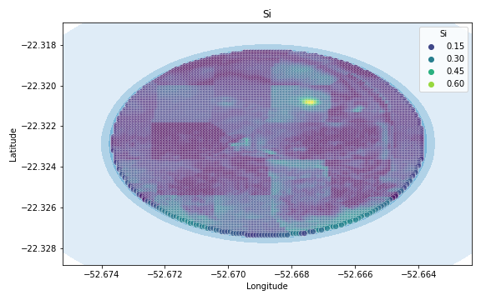
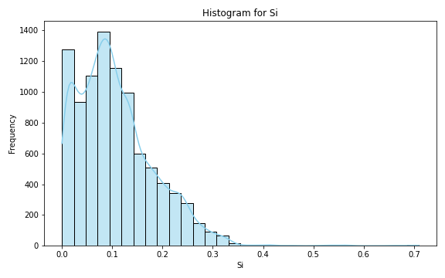
Analysis for column: Si Model: Neural Network
Statistics:
mean 0.106613
std 0.076340
min 0.000016
25% 0.050420
50% 0.093964
75% 0.147088
80% 0.166495
85% 0.188254
90% 0.216085
95% 0.246681
99% 0.314959

Slide 17
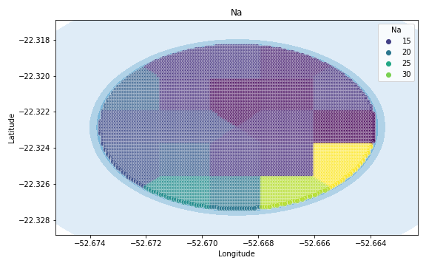
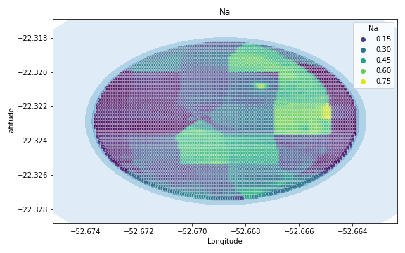

Analysis for column: Na Model: Neural Network
Statistics:
mean 0.263654
std 0.183968
min 0.000049
25% 0.105993
50% 0.219749
75% 0.440400
80% 0.493666
85% 0.519433
90% 0.540344
95% 0.585226
99% 0.620339

Slide 18



Analysis for column: Va Model: Neural Network
Statistics:
mean 0.659611
std 0.665555
min 0.000120
25% 0.233025
50% 0.505564
75% 0.776601
80% 0.849170
85% 1.008790
90% 1.304087
95% 2.235965
99% 3.459714

Slide 19



Analysis for column: DRIS_N Model: Neural Network
Statistics:
mean inf
std NaN
min 0.000387
25% 0.325661
50% 0.654843
75% 2.281359
80% 3.738027
85% 4.894976
90% 5.790872
95% 39.348072
99% NaN

Slide 20



Analysis for column: DRIS_P Model: Neural Network
Statistics:
mean 0.425207
std 0.800358
min 0.000041
25% 0.085934
50% 0.162039
75% 0.312962
80% 0.428181
85% 0.674296
90% 0.990853
95% 1.608936
99% 4.047214

Slide 21



Analysis for column: DRIS_K Model: Neural Network
Statistics:
mean 2.566896
std 5.909404
min 0.000032
25% 0.367264
50% 0.684889
75% 1.817991
80% 2.307610
85% 3.208733
90% 4.683608
95% 14.397341
99% 33.644826

Slide 22



Analysis for column: DRIS_Ca Model: Neural Network
Statistics:
mean 1.538431
std 3.263677
min 0.000239
25% 0.222206
50% 0.535242
75% 1.330485
80% 1.734495
85% 2.183630
90% 2.533245
95% 11.699165
99% 16.935535

Slide 23



Analysis for column: DRIS_Mg Model: Neural Network
Statistics:
mean 1.923103
std 4.102636
min 0.000329
25% 0.246820
50% 0.488844
75% 0.937343
80% 1.193707
85% 1.438313
90% 5.894706
95% 13.813587
99% 17.609532

Slide 24



Analysis for column: DRIS_S Model: Neural Network
Statistics:
mean 0.869265
std 2.348719
min 0.000069
25% 0.138792
50% 0.320751
75% 0.546320
80% 0.605234
85% 0.693463
90% 0.910355
95% 1.731881
99% 13.118681

Slide 25



Analysis for column: DRIS_B Model: Neural Network
Statistics:
mean 1.546382
std 3.690627
min 0.000130
25% 0.214967
50% 0.336467
75% 0.864123
80% 1.356288
85% 1.878648
90% 3.211808
95% 12.691702
99% 18.389709

Slide 26



Analysis for column: DRIS_Cu Model: Neural Network
Statistics:
mean 0.443274
std 1.401465
min 0.000042
25% 0.067441
50% 0.125679
75% 0.213255
80% 0.241227
85% 0.274440
90% 0.337025
95% 0.507843
99% 7.143944

Slide 27



Analysis for column: DRIS_Fe Model: Neural Network
Statistics:
mean 1.033533
std 0.871497
min 0.000302
25% 0.442322
50% 0.775977
75% 1.373490
80% 1.581492
85% 1.875412
90% 2.226585
95% 2.851658
99% 4.032131

Slide 28



Analysis for column: DRIS_Mn Model: Neural Network
Statistics:
mean 0.301607
std 0.537303
min 0.000082
25% 0.083010
50% 0.173386
75% 0.285007
80% 0.317609
85% 0.366516
90% 0.453975
95% 0.711219
99% 2.909428

Slide 29



Analysis for column: DRIS_Zn Model: Neural Network
Statistics:
mean 0.764715
std 1.643160
min 0.000058
25% 0.145565
50% 0.307459
75% 0.546240
80% 0.683274
85% 0.962735
90% 1.250630
95% 3.178456
99% 8.982011

Slide 30



Analysis for column: IMS Model: Neural Network
Statistics:
mean 1.170072
std 2.442733
min 0.000031
25% 0.153811
50% 0.284183
75% 0.597628
80% 0.861208
85% 2.694041
90% 3.312296
95% 5.883181
99% 15.246813

Slide 31



Analysis for column: IBN Model: Neural Network
Statistics:
mean 0.533275
std 1.790795
min 0.000019
25% 0.071289
50% 0.142670
75% 0.215623
80% 0.239920
85% 0.276605
90% 0.345798
95% 0.467977
99% 9.288169

